Slide 1
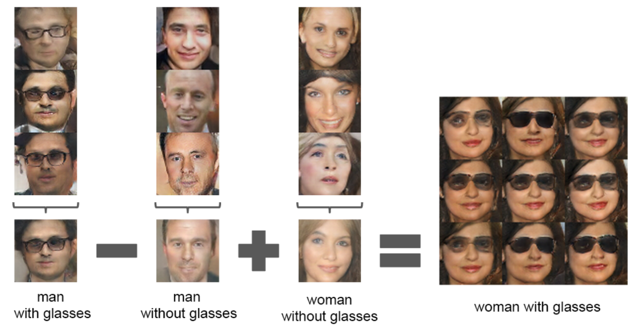
Latent Vectors Generated by GAN

Slide 2
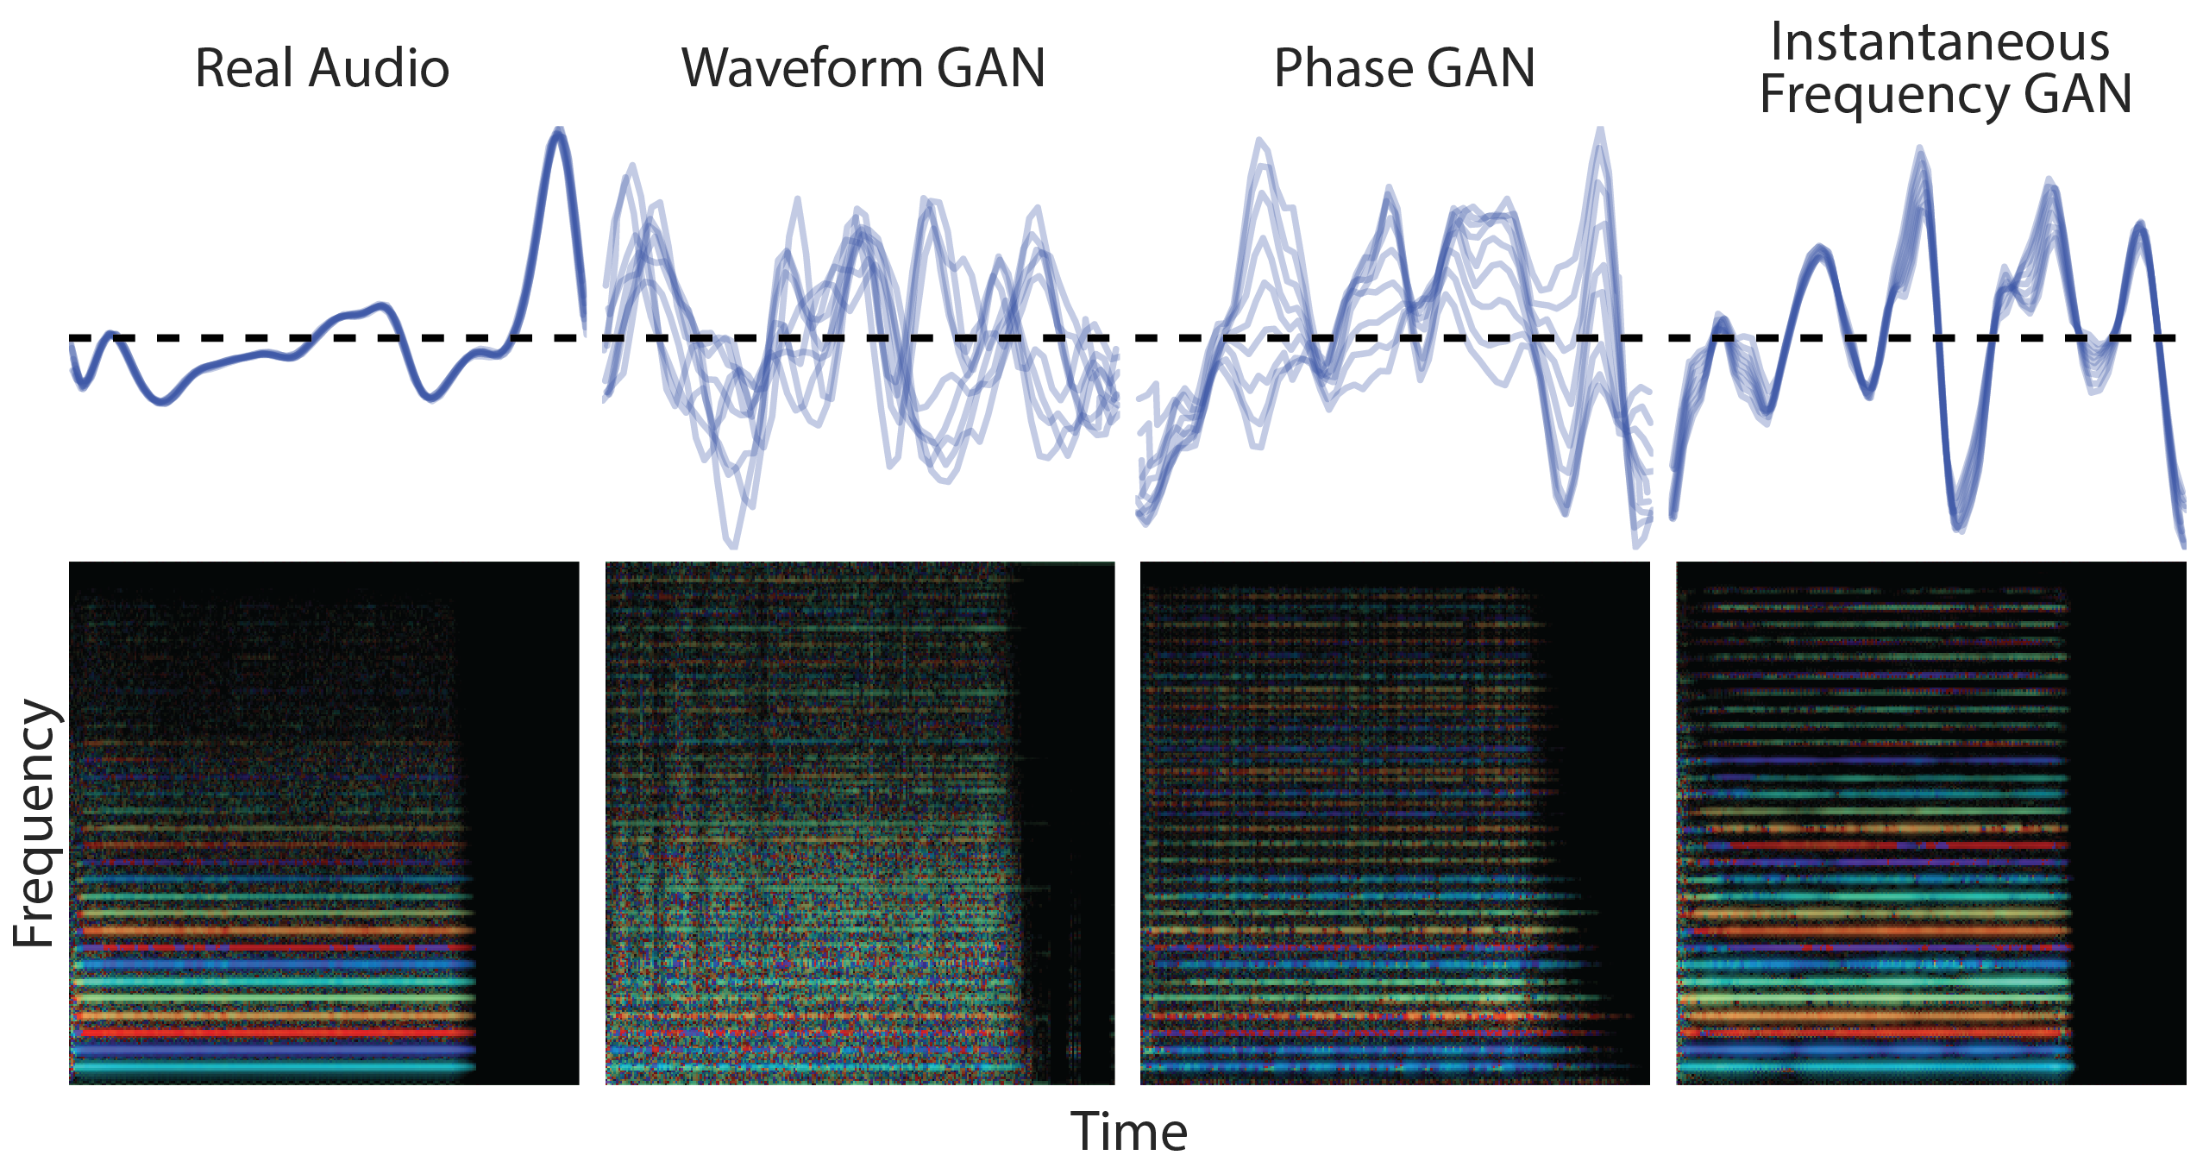
GAN Music
Source: gansynth

Slide 3
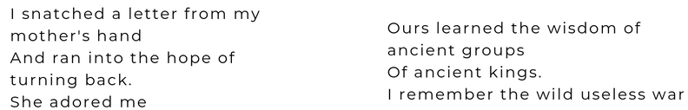
Generation of Poems
https://www.ai-fragments.com/

Slide 4
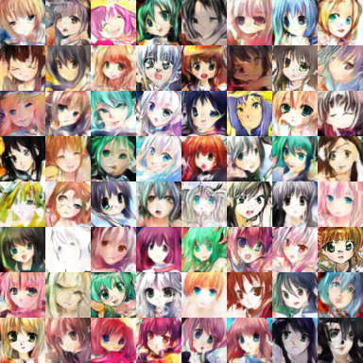




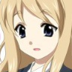


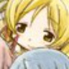
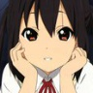
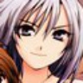

Generation of Cartoon Figures
Source of images: https://zhuanlan.zhihu.com/p/24767059
From Dr. HY Lee’s notes.

Slide 5
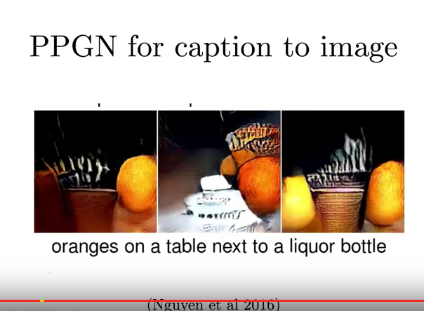
Natural Language to Images

Slide 6
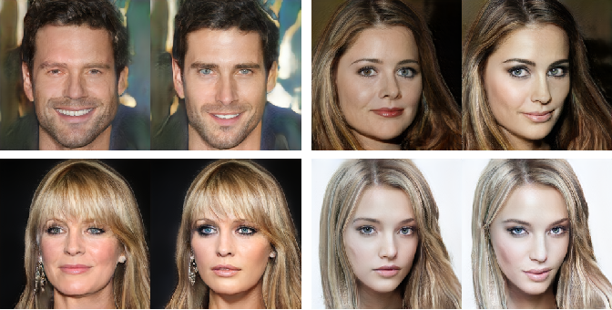
Image Beautification
Source: BeHolder-GAN

Slide 7
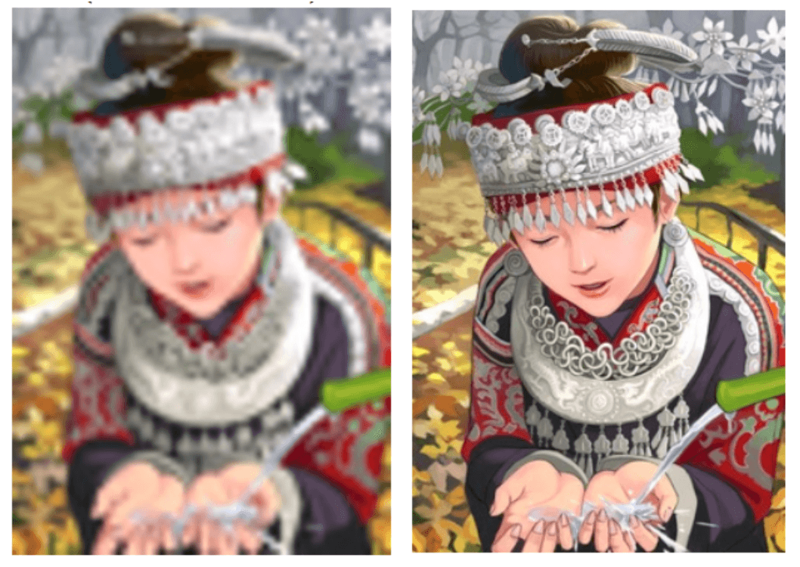
Image Super-Resolution
Convert Low Resolution Images into High Resolution Images
Photo-Realistic Single Image Super-Resolution Using a Generative Adversarial Network, Ledig et al., arXiv:1609.04802

Slide 8
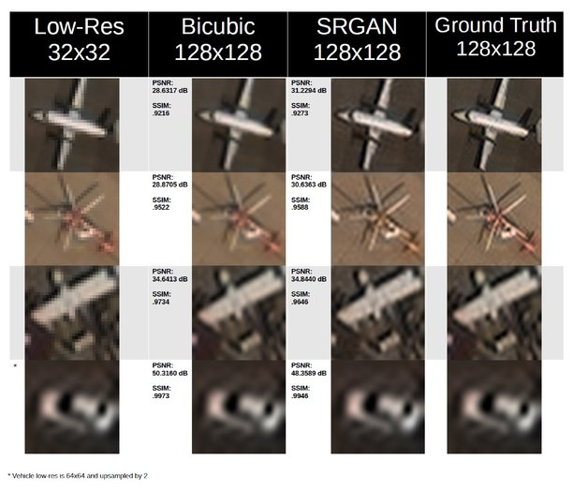
Image Super-Resolution in Military Applications
Jonathan Chin and Asif Mehmood "Generative adversarial networks based super resolution of satellite aircraft imagery", Proc. SPIE 10995, Pattern Recognition and Tracking XXX, 109950W, 2019;
https://doi.org/10.1117/12.2524720

Slide 9
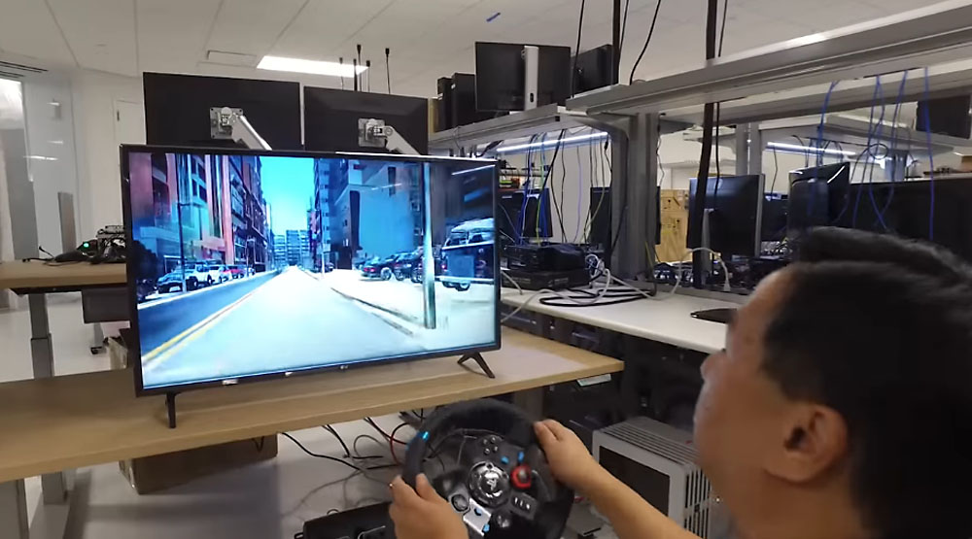
GAN Generates Realistic Scenarios for Training

Slide 10
Generative Adversarial Network (GAN)
Adversarial Learning
GAN Architecture
DCGAN
GAN Applications
The Fundamentals of GAN
FAT-GAN

Slide 11
Fundamentals of GAN
Generator G
A Function: Input z, Output x
Given a prior distribution P_{prior}(z), a probability distribution P_{G}(x) is defined by function G
Discriminator D
A Function: Input x, Output a scalar
Evaluate the difference between P_{G}(x) and P_{data}(x)

Slide 12
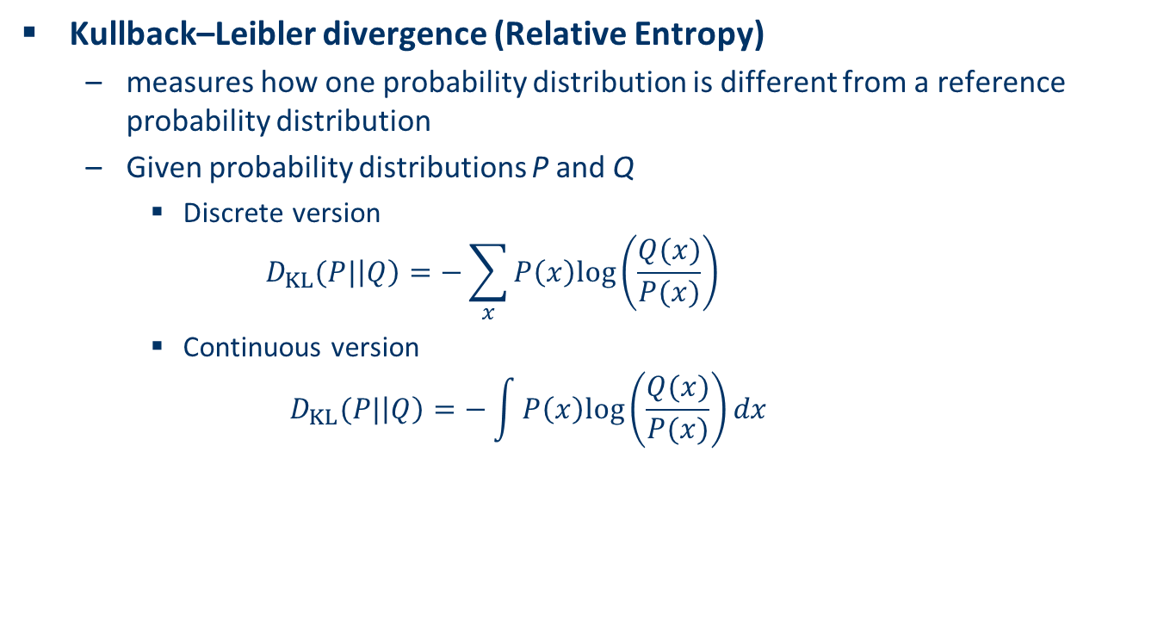
Kullback–Leibler Divergence
Kullback–Leibler divergence (Relative Entropy)
measures how one probability distribution is different from a reference probability distribution
Given probability distributions P and Q
Discrete version
$$D_{KL}(P|\left|Q\right)=−\sum_{x}{P\left(x\right)log⁡\left(\frac{Q(x)}{P(x)}\right)}$$
Continuous version
$$D_{KL}(P|\left|Q\right)=−\int{P\left(x\right)log⁡\left(\frac{Q(x)}{P(x)}\right)}dx$$

Slide 13
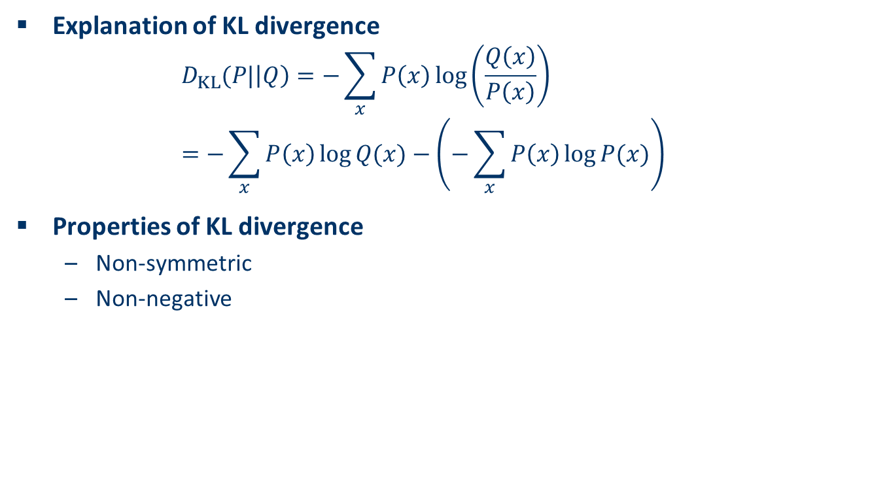
Properties of Kullback–Leibler Divergence
Explanation of KL divergence
$$D_{KL}(P|\left|Q\right)=−\sum_{x}{P\left(x\right)\log\left(\frac{Q\left(x\right)}{P\left(x\right)}\right)} \\ =−\sum_{x}{P\left(x\right)\log{Q(x)}}−\left(−\sum_{x}{P\left(x\right)\log{P(x)}}\right)$$
Properties of KL divergence
Non-symmetric
Non-negative
Cross Entropy of P and Q
Entropy of P
Notes:
Note that ln⁡a ≤ a−1 for all a>0.
We will now show that −DKL(p||q)≤0 which means that DKL(p||q)≥0
−D(p||q)=−∑p(x)lnp(x)/q(x)=∑p(x)lnq(x)/p(x)≤∑p(x)(q(x)/p(x)−1)=∑q(x)−∑p(x)=1−1=0

Slide 14
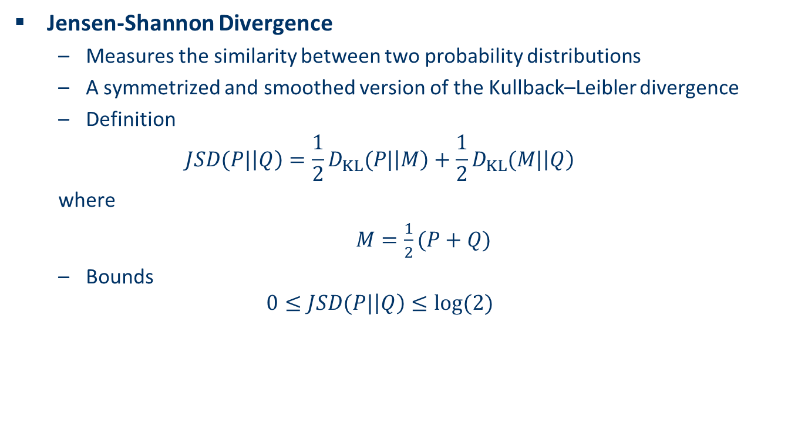
Jensen-Shannon Divergence
Jensen-Shannon Divergence
Measures the similarity between two probability distributions
A symmetrized and smoothed version of the Kullback–Leibler divergence
Definition
$$JSD(P|\left|Q\right)=\frac{1}{2}D_{KL}(P|\left|M\right)+\frac{1}{2}D_{KL}(M|\left|Q\right)$$
where
$M=\frac{1}{2}(P+Q)$
Bounds
$$0≤JSD(P|\left|Q\right)≤log⁡(2)$$

Slide 15
GAN Cost Function
An optimization problem
Find an optimal generator G* such that
G*=arg min_{G}max_{D}V(G,D)
A minimax algorithm
Jensen-Shannon Divergence (Information Radius)
V = E_{x~P_data} [log D(x)] + E_{x~P_G}[log(1-D(x))]
Measures the similarity between two distributions

Slide 16
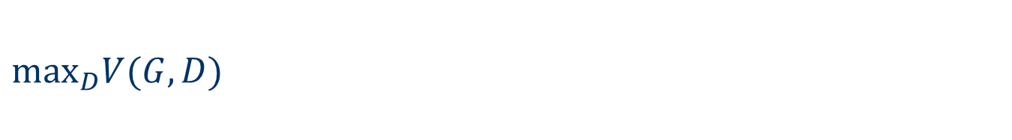
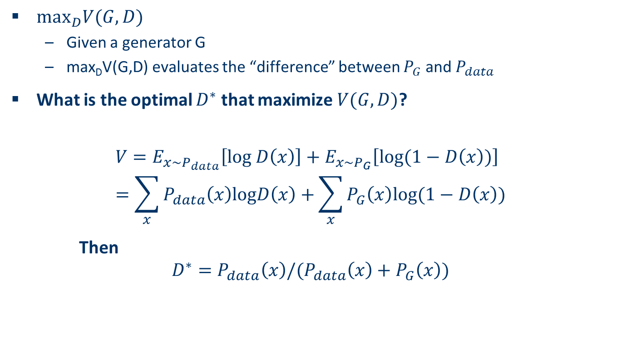
$\max_{D}V(G, D)$
$\max_{D}V(G, D)$
Given a generator G
max_{D}V(G,D) evaluates the “difference” between $P_{G}$ and $P_{data}$
What is the optimal $D^{∗}$ that maximize $V(G,D)$?
$$V=E_{x\sim P_{data}}\left[log D\left(x\right)\right]+E_{x\sim P_{G}}\left[log(1−D\left(x\right))\right] \\ =\sum_{x}{P_{data}\left(x\right)logD\left(x\right)+}\sum_{x}{P_{G}\left(x\right)log(1−D\left(x\right))}$$
Then
$$D^{∗}=P_{data}\left(x\right)/(P_{data}\left(x\right)+P_{G}\left(x\right))$$
Notes:
f(D) = alogD + blog(1-D) ➔ D*=a/(a+b)

Slide 17
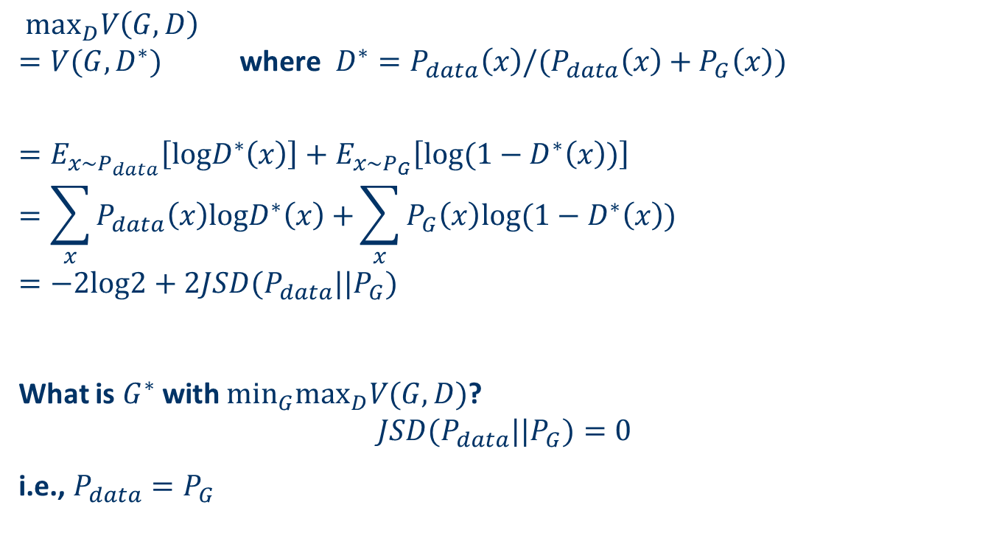
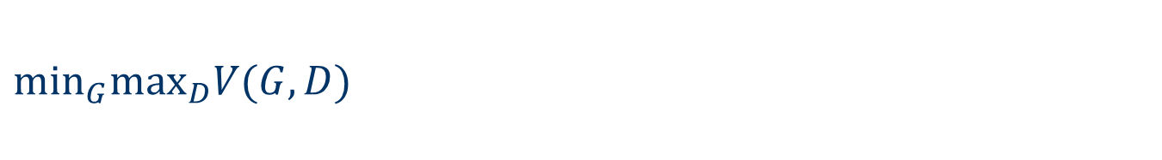
$\min_{G}\max_{D}V(G, D)$
$\max_{D}V\left(G, D\right)$ $=V(G,D^{∗})$ where $D^{∗}=P_{data}\left(x\right)/(P_{data}\left(x\right)+P_{G}\left(x\right))$
$$=E_{x\sim P_{data}}\left[logD^{∗}\left(x\right)\right]+E_{x\sim P_{G}}\left[log(1−D^{∗}\left(x\right))\right]$$
$$=\sum_{x}{P_{data}\left(x\right)logD^{∗}\left(x\right)+}\sum_{x}{P_{G}\left(x\right)log(1−D^{∗}\left(x\right))}$$
$$=−2log2+2JSD(P_{data}||P_{G})$$
What is $G^{∗}$ with $\min_{G}\max_{D}V(G, D)$?
$$JSD(P_{data}||P_{G})=0$$
i.e., $P_{data}=P_{G}$

Slide 18
Problems in Training a GAN
Training a GAN is notoriously difficult
Perfect Discriminator
Mode Collapse
Non-convergence
Imbalance Generator and Discriminator Training
Model parameter oscillation
Destabilization
Vanishing gradient

Slide 19
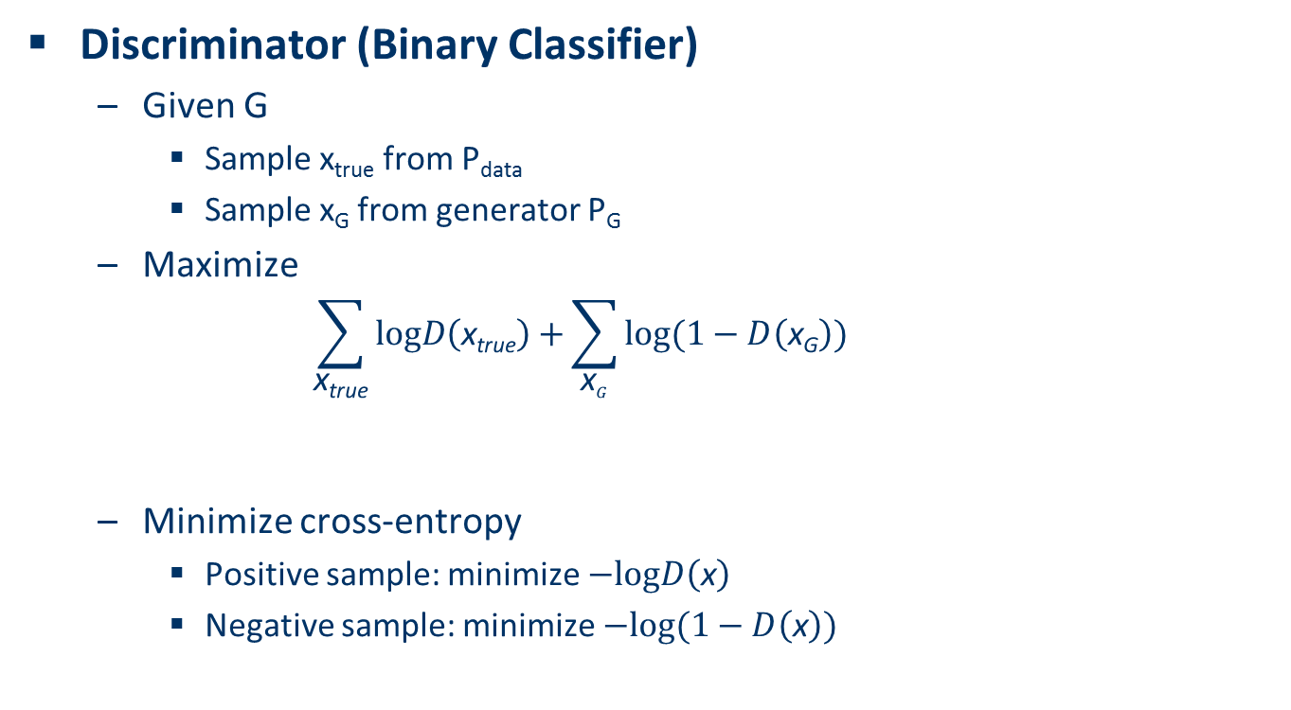
Training GAN in Practice
Discriminator (Binary Classifier)
Given G
Sample x_{true} from P_{data}
Sample x_{G} from generator P_{G}
Maximize
$$\sum_{\text{x}\text{true}}{logD\left(\text{x}\text{true}\right)+}\sum_{\text{x}G}{log(1−D\left(\text{x}\text{G}\right))}$$
Minimize cross-entropy
Positive sample: minimize $−logD\left(\text{x}\right)$
Negative sample: minimize $−log(1−D\left(\text{x}\right))$
If x is true
If x is fake

Slide 20
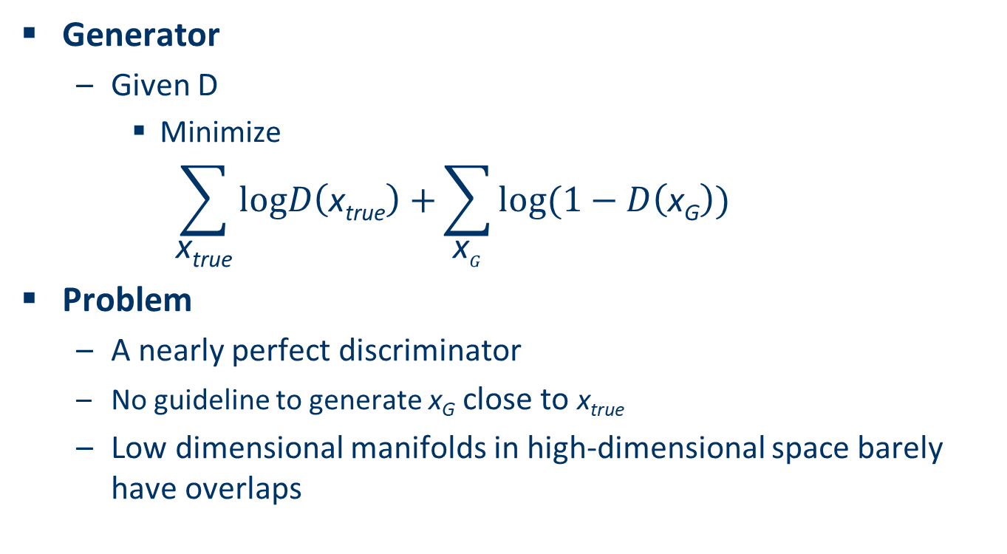
Too Perfect Discriminator
Generator
Given D
Minimize
$$\sum_{\text{x}\text{true}}{logD\left(\text{x}\text{true}\right)+}\sum_{\text{x}G}{log(1−D\left(\text{x}\text{G}\right))}$$
Problem
A nearly perfect discriminator
No guideline to generate $\text{x}\text{G}$ close to $\text{x}\text{true}$
Low dimensional manifolds in high-dimensional space barely have overlaps

Slide 21
Too Perfect Discriminator
P_{G_0}(x)
JSD(P_{G_0} || P_{data}) = log2
P_{data}(x)
……
Better
P_{G_50}(x)
P_{data}(x)
JSD(P_{G_50} || P_{data}) = log2
Not really better ……
……
P_{G_100}(x)
P_{data}(x)
JSD(P_{G_100} || P_{data}) = 0
Slide Credit: University of Waterloo, M. Li

Slide 22
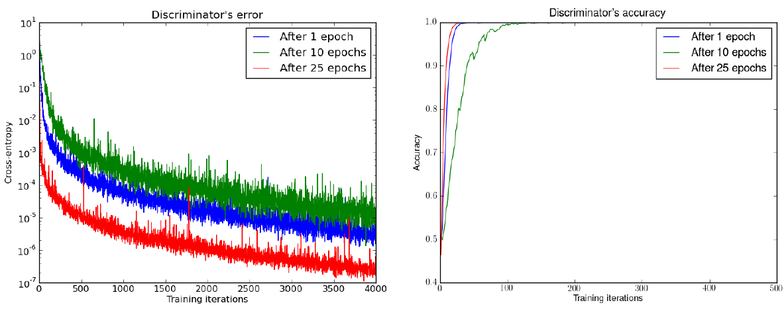
Discriminator too perfect
Discriminator is too strong: for all three Generators, JSD = 0
Martin Arjovsky, Léon Bottou, Towards Principled Methods for Training Generative Adversarial Networks, 2017, arXiv preprint

Slide 23
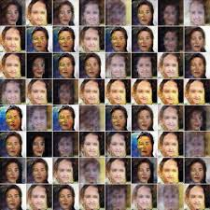
Mode Collapse
Generating the same sample

Slide 24
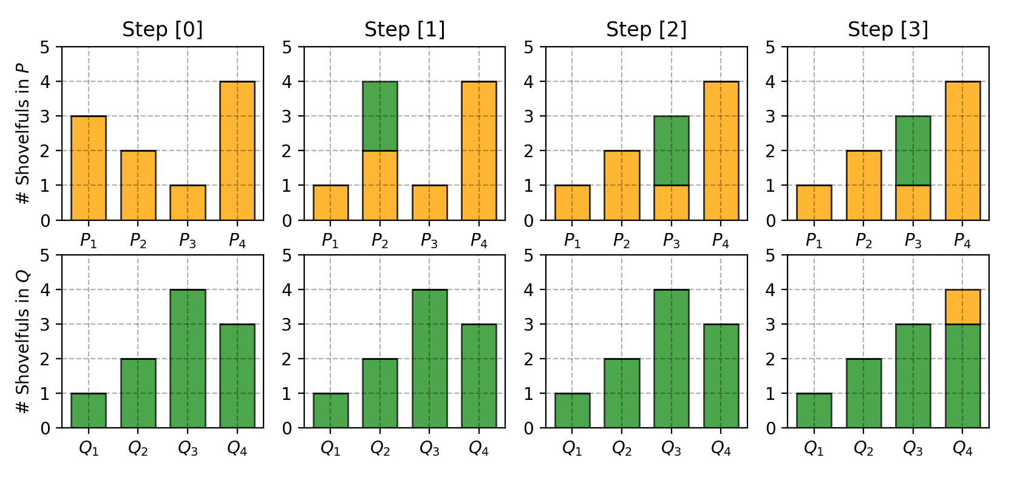
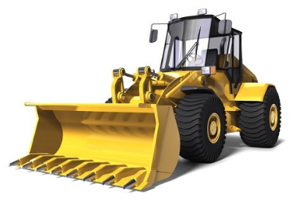
Wasserstein Distance
Wasserstein Distance (Earth Mover’s Distance)
Measure of the distance between two probability distributions
Interpreted as the minimum energy cost of moving and transforming a pile of dirt in the shape of one probability distribution to that of the other
Toy Example: Matching Distributions P and Q
P1=3,P2=2,P3=1,P4=4
Q1=1,Q2=2,Q3=4,Q4=3

Slide 25
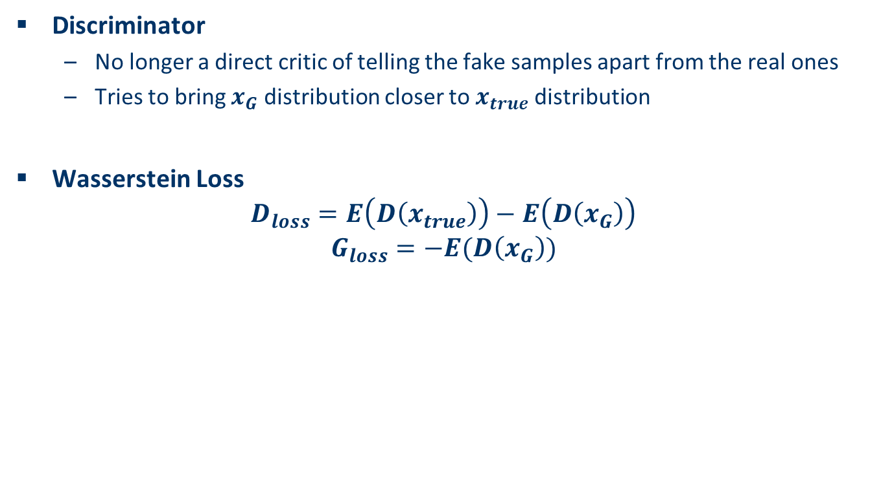
Wasserstein GAN
Discriminator
No longer a direct critic of telling the fake samples apart from the real ones
Tries to bring $x_{G}$ distribution closer to $x_{true}$ distribution
Wasserstein Loss
$$D_{loss}=E\left(D\left(x_{true}\right)\right)−E\left(D\left(x_{G}\right)\right)$$
$$G_{loss}=−E(D\left(x_{G}\right))$$

Slide 26
Wasserstein Distance vs. JSD
d₀
d₅₀
d₁₀₀
P_{G_0}
P_{data}
……
P_{G_50}
P_{data}
……
P_{G_100}
P_{data}
JS(P_{G_0}, P_{data}) = log2
JS(P_{G_50}, P_{data}) = log2
JS(P_{G_100}, P_{data}) = 0
W(P_{G_0}, P_{data})=d₀
W(P_{G_50}, P_{data})=d₅₀
W(P_{G_100}, P_{data})=0

Slide 27
Generative Adversarial Network (GAN)
Adversarial Learning
GAN Architecture
DCGAN
GAN Applications
The Fundamentals of GAN
FAT-GAN

Slide 28
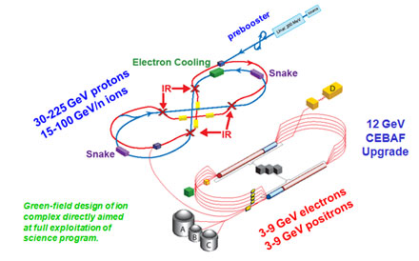
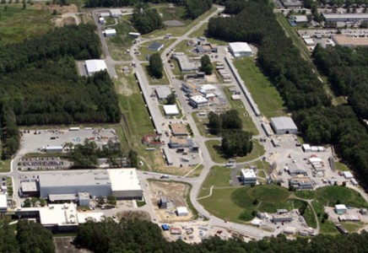
Simulation of Physics Events
Jefferson Lab Electron-Proton Collider

Slide 29
GAN-based Event Generators
Learning from real electron-proton scattering data
Capture rich underlying distributions over data
Difficult to model using explicit parameters
Faithfully reproducing particle reaction events
No assumptions on femtometer-scale physics theory
Overcome the limitations of MCEGs
Proof-of-concept on inclusive electrons

Slide 30
Additional (GAN) Challenges
Precise Event Feature Distributions
Replicate the nature of particle reactions faithfully
Obeying the fundamental Physics Laws
Energy Conservation
Momentum Conservation

Slide 31
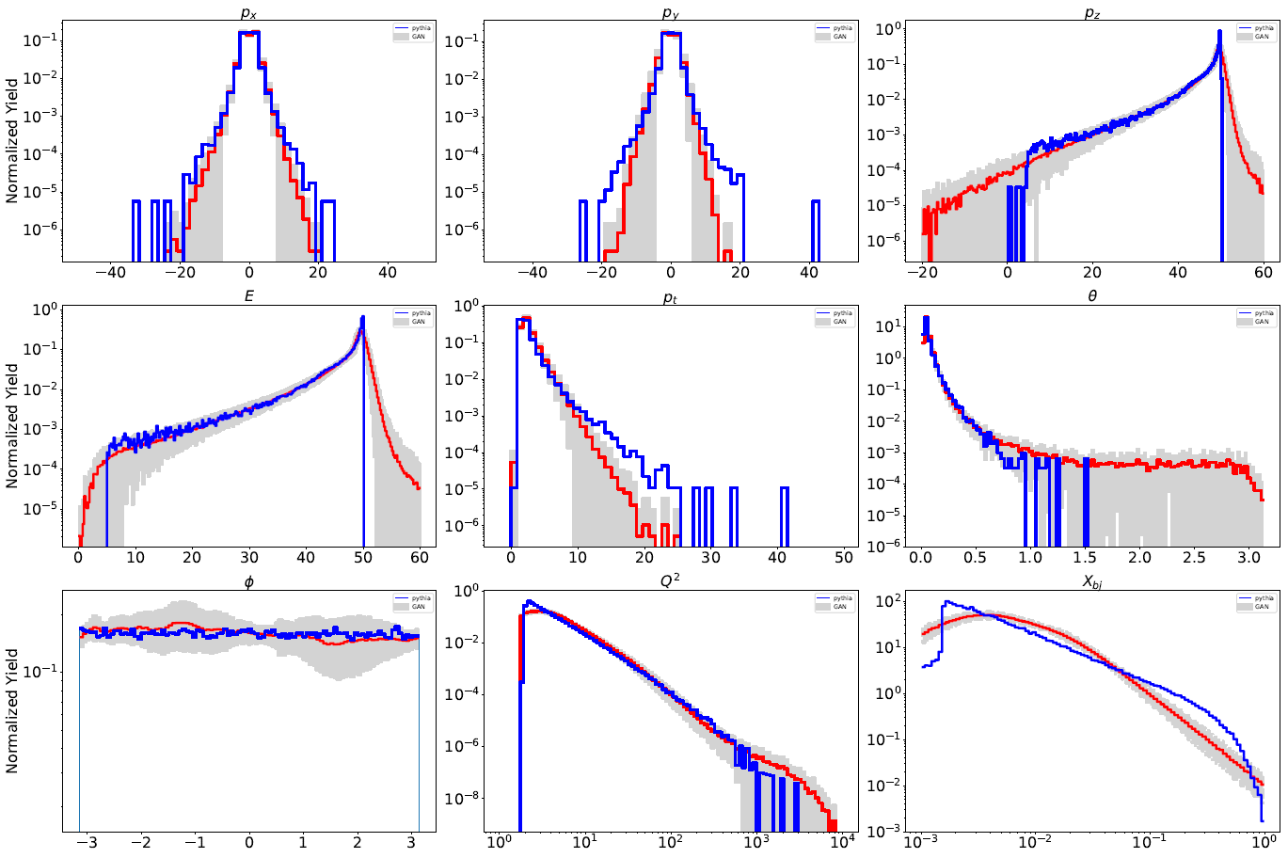
Direct Simulation GAN
Directly learn from electron three-momentum vector (px, py, pz)

Slide 32
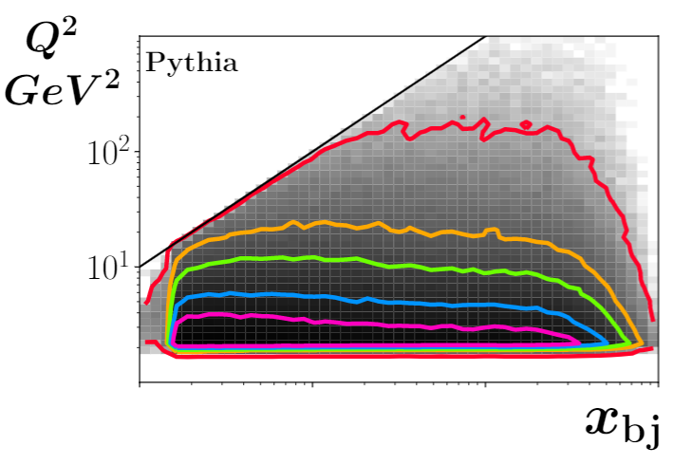
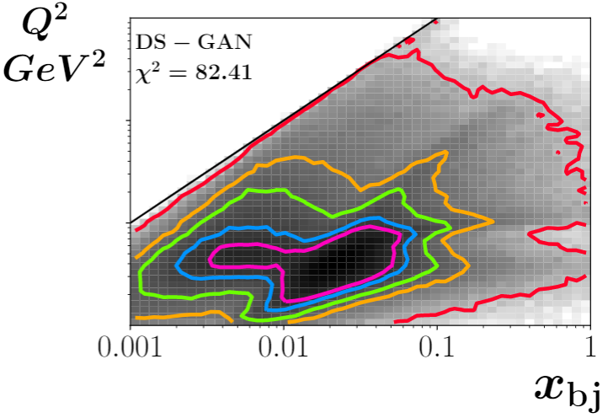
Direct Simulation GAN (cont.)
Inter-correlation between physical quantities

Slide 33
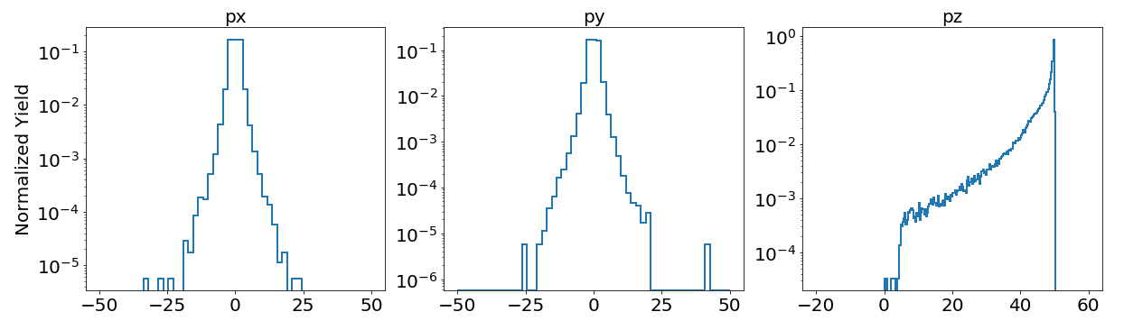
Momenta Distributions of Electrons

Slide 34
Feature-Augmented Transformed GAN (FAT-GAN)
FAT-GAN
Features Transformation
Select generated features
Not necessary meaningful physics properties
Easier to be generated by the generator
Features Augmentation
Expand feature space
Improve sensitivity of the discriminator
Maximum Mean Discrepancy (MMD)
Improve Distribution Match
Wasserstein Loss
Reduce the chance of mode collapse
Enhance GAN convergence

Slide 35
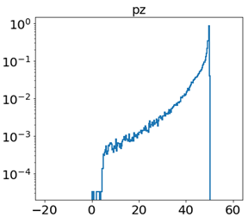
Features Transformation
Conversion to eliminate sharp edges
Guarantee no generation of non-physical electrons

Slide 36
Features Augmentation
Augment the Feature Space to improve the Sensitivity of Discriminator

Slide 37
Maximum Mean Discrepancy (MMD)
MMD
A kernel-based two-sample test to compare two distributions
Determine if the two sets of samples are drawn from different distributions
is a Gaussian kernel

Slide 38
FAT-GAN Architecture
Discriminator Loss
Generator Loss

Slide 39
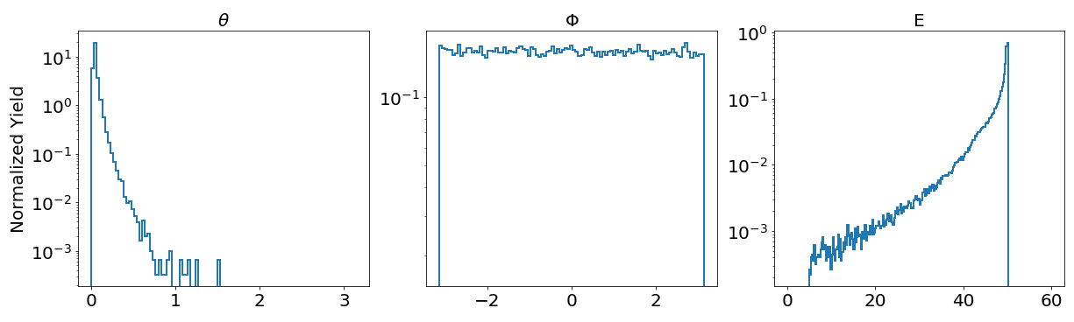
Comparison between Representations in Cartesian Coordinates and Spherical Coordinates
Representation in Cartesian Coordinates [FAT-GAN (Cart)]
Representation in Spherical Coordinates [FAT-GAN (Spher)]

Slide 40
Distributions of Generated Physical Properties

Slide 41
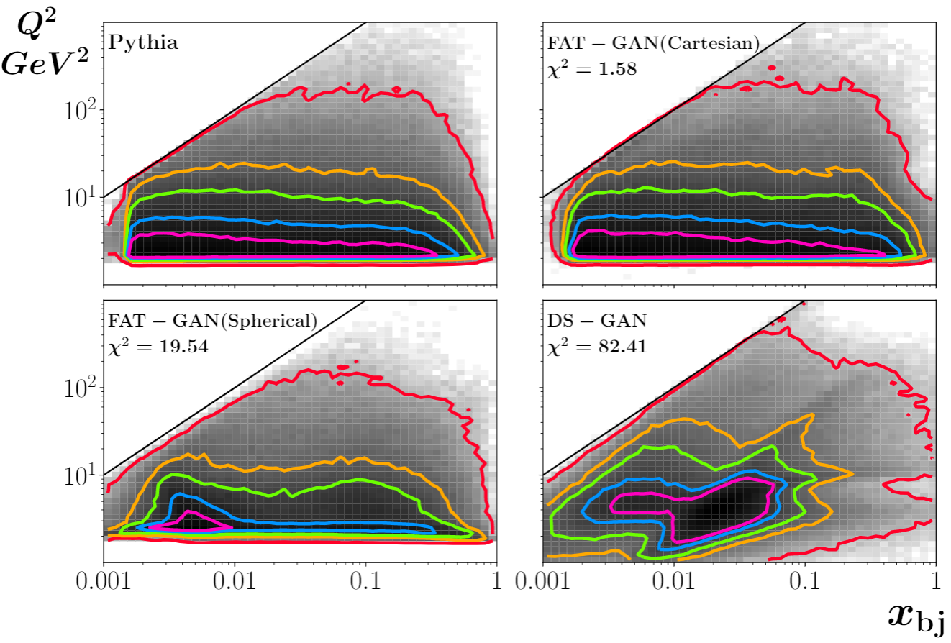
Features Inter-correlations

Slide 42
Convergence Comparison

Slide 43
Summary
GAN
Adversarial Training
Can mimic any data distributions
Mathematics under a GAN
Problems of Training a GAN
Attractive but Difficult to Train
FAT-GAN
DCGAN

